Slide 1
Sexual Harassment
What Every Student Needs To Know

Slide 2
What Is Sexual Harassment?

Slide 3
What Is Sexual Harassment?
Sexual harassment means bothering someone in a sexual way.
Sexual harassment is behavior that is not only
unwelcome, but in most cases repeated.
Sexual harassment is defined from the victim's
point of view, not the harasser's.
The goal of sexual harassment is not sexual
pleasure, but gaining power over another.
Sexual harassment is against the law.

Slide 4
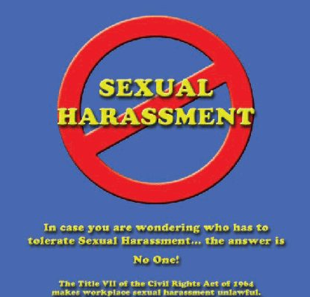
Who Has To Tolerate Sexual Harassment?
NO ONE!!

Slide 5
Federal Law
Illegal sexual harassment falls into four categories:
A.QUID PRO QUO
B.HOSTILE ENVIRONMENT
C.SEXUAL FAVORITISM
D.HARASSMENT BY NON-EMPLOYEES

Slide 6
Quid Pro Quo
A person suggests something will be given in return for sexual favors

Slide 7
Hostile Environment
Repeated unwelcome sexual conduct (jokes, posters, statements, behavior) has the effect of "poisoning" the employee's work environment

Slide 8
Sexual Favoritism
A supervisor rewards only those employees who submit to sexual demands

Slide 9
Harassment by Non-employees
There is harassment by people outside the company, over whose actions the employer has control or could have control

Slide 10
STATE LAW
California law defines sexual harassment as the following:
VISUAL HARASSMENT - derogatory posters, cartoons, or drawings; unwanted love letters or notes
VERBAL HARASSMENT - derogatory comments or slurs, suggestive or insulting sounds, comments about anatomy or clothes
PHYSICAL HARASSMENT - assault, impeding or blocking movement, or any physical interference with normal work or movement, when directed at an individual
SEXUAL FAVORS - unwanted sexual advances which make an employment benefit contingent upon an exchange of sexual favors

Slide 11
Sexual Harassment: Quid Pro Quo
Quid Pro Quo occurs when submission to, or refusal to submit to, sexual conduct is used to make employment decisions.
Any conduct by a manager that reasonably causes a subordinate employee to feel pressure to enter into a sexual or romantic relationship as a condition of employment can be quid pro quo harassment

Slide 12
Examples: Quid Pro Quo
Telling an applicant that you will hire her only if she's willing to "make your life sweet, on and off the job"
Promising a subordinate better work assignments and higher evaluations if they will have a romantic relationship with you
Downgrading an employee's performance evaluation because they won't become sexually involved with you

Slide 13
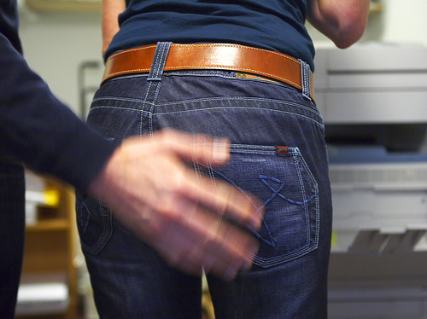
Sexual Harassement: Hostile Environnent
A hostile environment arises from inattentive management allowing a pattern of sexual conduct in the workplace so severe that it creates an intimidating, hostile or offensive work environment.
Hostile environment can exist even if there are no sexual advances or romantic overtures.
Display of pornography or sexually suggestive images
Sexual banter between employees
Leering
Sexual jokes
Unwanted touching of a sexual nature

Slide 14
How to Determine Whether an Environment is Sexually Hostile
Conduct must be severe and pervasive.
Trivial or merely annoying conduct will not sufficiently alter and an employee’s working conditions. Hypersensitive employees will not automatically be entitled to relief.

Slide 15
How to Determine Whether an Environment is Sexually Hostile
A pattern of offensive conduct generally required
Generally, a single incident or isolated incidents of sexual conduct will not be sufficient to show environmental harassment. However, if the conduct is severe (e.g. unwanted sexual touching), even a single incident can be sufficient to cause liability.

Slide 16
How to Determine Whether an Environment is Sexually Hostile
Evaluated from the view of a "reasonable woman or man"
The victim's perspective, not stereotypes of acceptable behavior, will be used. The historic atmosphere of the workplace will not excuse offensive behavior. For example, harassment is prohibited in a warehouse work area to the same extent it is prohibited in an office environment.

Slide 17
How to Determine Whether an Environment is Sexually Hostile
Not necessary for the victim to suffer psychological injury.
A claim of hostile environment harassment can arise even if conduct is not sufficiently severe to cause psychological stress. The conduct need only be offensive to a reasonable person.

Slide 18
How to Determine Whether an Environment is Sexually Hostile
Any sexual conduct in the workplace can cause a problem
Even if sexual conduct is not sufficiently outrageous to create a legally valid harassment claim, it can create serious employee relations problems and make an invalid claim more difficult to defend.

Slide 19
How to Determine Whether an Environment is Sexually Hostile
Any sexual conduct in the workplace can cause a problem
Even if sexual conduct is not sufficiently outrageous to create a legally valid harassment claim, it can create serious employee relations problems and make an invalid claim more difficult to defend.

