Slide 1

SEXUAL HARASSMENT BEHAVIOR PATTERNS
VISUAL HARASSMENT
VISUAL
Staring
Leering
Obscene gestures
WRITTEN
Unwanted:
Love poems
Love letters
Cards
Obscene poems
Sexually suggestive:
Cartoons
Posters
Drawings
Magazines
Flyers
Displaying sexually suggestive objects or pictures

Slide 2
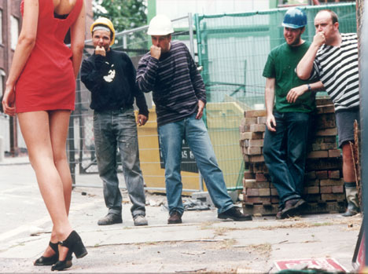
SEXUAL HARASSMENT BEHAVIOR PATTERNS
VERBAL HARASSMENT
Unwanted requests for dates
Questions about personal life
Indecent comments
Dirty/sexual jokes
Sexually explicit or degrading words
Name calling
Suggestive or insulting sounds
Graphic, verbal comments about another’s dress or body
Whistling

Slide 3
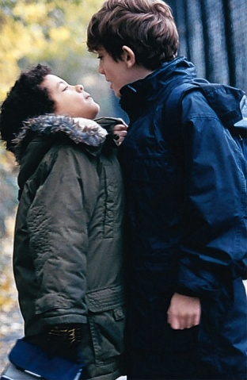
SEXUAL HARASSMENT BEHAVIOR PATTERNS
SEXUAL FAVORS
POWER
Relationships
Using position to request dates,
sex, etc.
THREATS
Quid pro Quo
(Something is given in return for something else.)
Demands
Loss of job
Selection Process:
  demotion
  promotion
  raise, etc.

Slide 4

SEXUAL HARASSMENT BEHAVIOR PATTERNS
PHYSICAL HARASSMENT
VIOLATING SPACE
Blocking
Following
Cornering
TOUCHING
Patting
Grabbing
Caressing
Kissing
Brushing against
another’s body
FORCE
Rape
Physical assault

Slide 5
EXAMPLES OF SEXUAL HARASSMENT
VERBAL
Referring to an adult as a girl, hunk, doll, babe, or honey
Whistling at someone, cat calls
Making sexual comments about a person's body
Making sexual comments or innuendos
Turning work discussions to sexual topics
Telling sexual jokes or stories

Slide 6

EXAMPLES OF SEXUAL HARASSMENT
VERBAL
Asking about sexual fantasies, preferences, or history
Asking personal questions about social or sexual life
Making sexual comments about a person's clothing, anatomy, or looks
Repeatedly asking out a person who is not interested
Making kissing sounds, howling, and smacking lips
Telling lies or spreading rumors about a person's personal sex life

Slide 7

EXAMPLES OF SEXUAL HARASSMENT
NON-VERBAL
Looking a person up and down (elevator eyes)
Staring at someone
Blocking a person's path
Following the person
Giving personal gifts
Displaying sexually suggestive visuals
Making facial expressions such a winking,
throwing kisses, or licking lips
Making sexual gestures with hands or through body movements

Slide 8
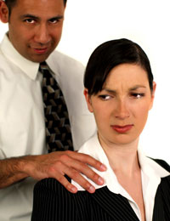
EXAMPLES OF SEXUAL HARASSMENT
PHYSICAL
Giving a massage around the neck
or shoulders
Touching the person's clothing, hair, or body
Hanging around a person
Hugging, kissing, patting, or stroking
Touching or rubbing oneself sexually around another person
Standing close or brushing up against a person

Slide 9
COMFORT ZONES
A comfort zone can be described as a circle you draw around yourself inside which you only allow those behaviors with which you are comfortable.
THESE BEHAVIORS INCLUDE:YOUR OWN
AND
THE BEHAVIORS OF OTHERS THAT YOU WILL ACCEPT WITHOUT CONSIDERING THE COMMENTS OR ACTIONS OFFENSIVE.

Slide 10
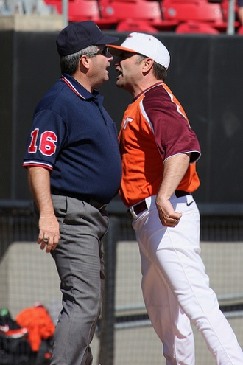
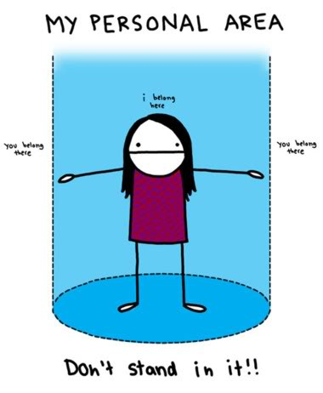
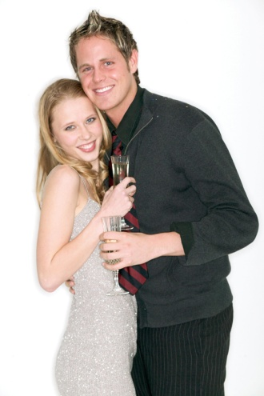
COMFORT ZONES
Each person has a different comfort zone.
Each person selects what she/he allows inside her/his comfort zone.
People have different comfort zones for different relationships; different times, and for different reasons.

Slide 11

COMFORT ZONES
(EXAMPLE)
DEGREE OF OFFENSIVENESS
Offensive
“You really fill out that outfit.”
Possibly Offensive
"You look great in that outfit."
Almost Never Offensive
"What a beautiful jacket!"

Slide 12
HOW DO YOU KNOW IF YOU ARE BEING SEXUALLY HARASSED?
ASK YOURSELF THESE QUESTIONS:
Am I bothered by this behavior?
How does it make me feel?
Is this behavior related to my job?
Is the behavior not asked for and unwelcome?
Are these behaviors of a sexual nature?

Slide 13
WHY SOME PEOPLE HESITATE IN TALKING
ABOUT SEXUAL HARASSMENT SITUATIONS
Often recipients of sexual harassment are very embarrassed and don't want to talk about it with anyone.
They fear that, if they talk about it, nothing will be done or the complaint won't be taken seriously.
They fear reprisal, from the harasser, especially if that person is their boss or a representative of management.

Slide 14

WHY SOME PEOPLE HESITATE IN TALKING
ABOUT SEXUAL HARASSMENT SITUATIONS
They may be concerned about being labeled a troublemaker, especially if they are new on the job.
They are afraid of being told that they "asked for it.”
They are afraid of being fired, demoted, not promoted, or transferred.
They blame themselves.

Slide 15



WHY SOME PEOPLE HESITATE IN TALKING
ABOUT SEXUAL HARASSMENT SITUATIONS
They are told by someone that they should be flattered.
They are afraid of being blamed or laughed at.
Many may fear for their personal safety.
Some women are told, "Be a good sport," “Can't you take a joke," "Boys will be boys," or "You've got to expect that in a traditionally male job".

Slide 16


WHY SOME PEOPLE HESITATE IN TALKING
ABOUT SEXUAL HARASSMENT SITUATIONS
They fear getting a bad reputation.
They're told to be woman or man enough to handle it themselves.
They don't want the sexual harasser to get in trouble.
The employees may be unaware of he organization's policy on sexual harassment

Slide 17
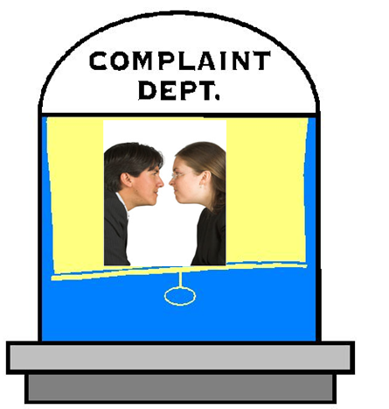
WHY SOME PEOPLE HESITATE IN TALKING
ABOUT SEXUAL HARASSMENT SITUATIONS
The sexual harassment resource person has a reputation for being a sexual harasser.
They don't want to get an industry-wide reputation as a complainer.
They are reluctant to talk to someone because no one else seems to mind the harasser's behavior.

Slide 18
WHY SOME PEOPLE HESITATE IN TALKING
ABOUT SEXUAL HARASSMENT SITUATIONS
They just don't know how to deal with the situation or whom they should talk to.
Some men are told, when harassed by a woman, "Go for it" "You should be flattered!” or "What's wrong with you?"
Men or women, when harassed by someone of the same gender, may be told, “Maybe you really like the same sex,” or “Why do you think he/she picked you?”

Slide 19
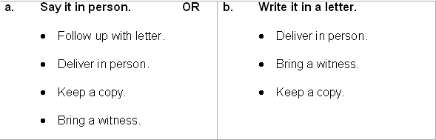
WHAT IF IT HAPPENS TO YOU?
WAYS TO HANDLE SEXUAL HARASSMENT
LET THE HARASSER KNOW THE BEHAVIOR IS UNWANTED.

Slide 20


WHAT IF IT HAPPENS TO YOU?
WAYS TO HANDLE SEXUAL HARASSMENT
TALK ABOUT THE SITUATION WITH SOMEONE.
  a friend
  a co-worker

Slide 21

WHAT IF IT HAPPENS TO YOU?
WAYS TO HANDLE SEXUAL HARASSMENT
KEEP A JOURNAL. DOCUMENT IN DETAIL ALL OF THE FOLLOWING:
  What happened
  Where and when it took place
  Your response
  Any witnesses
  Whom you told and what you said

Slide 22

WHAT IF IT HAPPENS TO YOU?
WAYS TO HANDLE SEXUAL HARASSMENT
FIND OUT IF THE HARASSER HAS HARASSED OTHERS FROM THE FOLLOWING SOURCES:
  witnesses
  other evidence from co-workers

Slide 23
WHAT IF IT HAPPENS TO YOU?
WAYS TO HANDLE SEXUAL HARASSMENT
IF THE FIRST MEETING OR LETTER DOES NOT STOP HARASSMENT, REPORT IT TO ONE OF THE FOLLOWING PEOPLE:
  Supervisor/personnel
  Whomever company policy says

Slide 24


WHAT IF IT HAPPENS TO YOU?
WAYS TO HANDLE SEXUAL HARASSMENT
IF THE HARASSMENT PERSISTS, FILE A WRITTEN COMPLAINT, USING THESE STEPS:
  Use company's grievance procedure.
  Seek support and advice from union, lawyer, women's groups other human rights agencies.

Slide 25
WHAT IF IT HAPPENS TO YOU?
WAYS TO HANDLE SEXUAL HARASSMENT
AFTER FILING WITH EITHER AGENCY, CONTACT ONE OF THE FOLLOWING FOR ADVICE:
  Lawyer
  Legal Aid Society
  Community legal services
  AFTER LEGAL CONSULTATION YOU MAY CHOOSE TO FILE A LAWSUIT BASED ON CALIFORNIA LAW.

Slide 26


WHAT IF IT HAPPENS TO YOU?
WAYS TO HANDLE SEXUAL HARASSMENT
IF COMPANY DOES NOT STOP HARASSMENT, FILE A COMPLAINT WITH ONE OF THE FOLLOWING AGENCIES:
  The Department of Fair Employment and Housing (state agency), if company has no more than 15 employees
  The Equal Employment Opportunity Commission (EEOC) (federal agency), if company has more than 15 employees

Slide 27
COMMUNICATION
POINTS TO REMEMBER WHEN CONFRONTING A SEXUAL HARASSER
THE "DO'S"
USE AN ASSERTIVE METHOD CALLED "THE BROKEN RECORD TECHNIQUE."
STATE YOUR POSITION AND KEEP REPEATING IT.
BE SPECIFIC.
BE CONSISTENT.
BE DIRECT AND CONFIDENT.

Slide 28
COMMUNICATION
POINTS TO REMEMBER WHEN CONFRONTING A SEXUAL HARASSER
THE "DO NOT'S"
DO NOT DEBATE OR ARGUE WITH THE HARASSER.
DO NOT ASSUME ANY RESPONSIBILITY FOR THE SITUATION.
DO NOT ANALYZE THE HARASSER'S PROBLEMS.
DO NOT REFER TO THE HARASSER'S PERSONAL LIFE.

Slide 29

Filing a Charge
The U.S. Equal Employment Opportunity Commission

Slide 30

GUIDELINES
HOW NOT TO SEXUALLY HARASS OTHERS
Until you learn otherwise, assume that a person you don’t know will NOT enjoy off-color jokes or sexual advances at work.
Sharpen your listening skills and pay attention to the other person’s verbal or physical responses. If someone’s responses seem negative, trust that they are. (Examples: Someone turns his/her eyes away or moves physically away).
If a person tells you NO, then assume that “NO” means “NO.”

Slide 31
IF YOU ARE UNSURE WHETHER YOUR WORKPLACE BEHAVIOR IS ACCEPTABLE
ASK YOURSELF THE FOLLOWING QUESTIONS:

Slide 32

Would I want someone to act this way toward someone I love?
(Ex: girlfriend/boyfriend, wife/husband, sister/brother)

Slide 33

Would I behave this way if a member of my family was standing next to me?

Slide 34

Would I want this behavior to be the subject of a column in the newspaper, or to appear on the evening news?

Slide 35
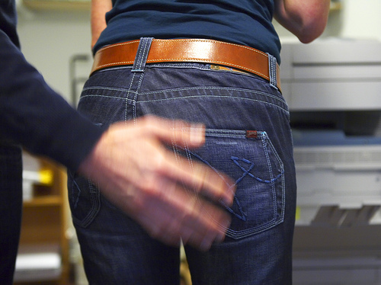
Is this behavior mutually acceptable to the other person and me?

Slide 36
Is there equal power/authority between the other person and me?

